Slide 1
SOLUTIONS
R
Lets get it sorted!
Team Skill-Up

Slide 2

REVIEW . REACH . RESOLVE
WHAT ARE WE
‘R Solutions’ helps Universities and students to stay organized and serve as a common platform for day-to-day academic related activities.

Slide 3
FEATURES
‘R Solutions’ helps Universities and students to stay organized and serve as a common platform for day-to-day academic related activities.
R Solutions can be used by 3 different roles to perform below mentioned functions:
As Student:
Make Fee Payment Online (Tuition Fee, Exam Fee, etc.)
View Exam Timetable
View Exam Results
Upload Document (Certificate, Marksheet etc.)
Download Documents (Hall Ticket, Exam Marksheet,
Provisional Certificate, Degree Certificate)
As Office Administrator:
Add/Delete Student details
Generate Tuition Fee & notify Students
Verify Student Document (View, Accept, Reject)
As Exam Co-Ordinator:
View Student details
Generate Exam Fee & notify Students
Add & Publish Exam Marksheet/results
Publish Exam Marksheet,
Provisional Certificate, Degree Certificate)

Slide 4
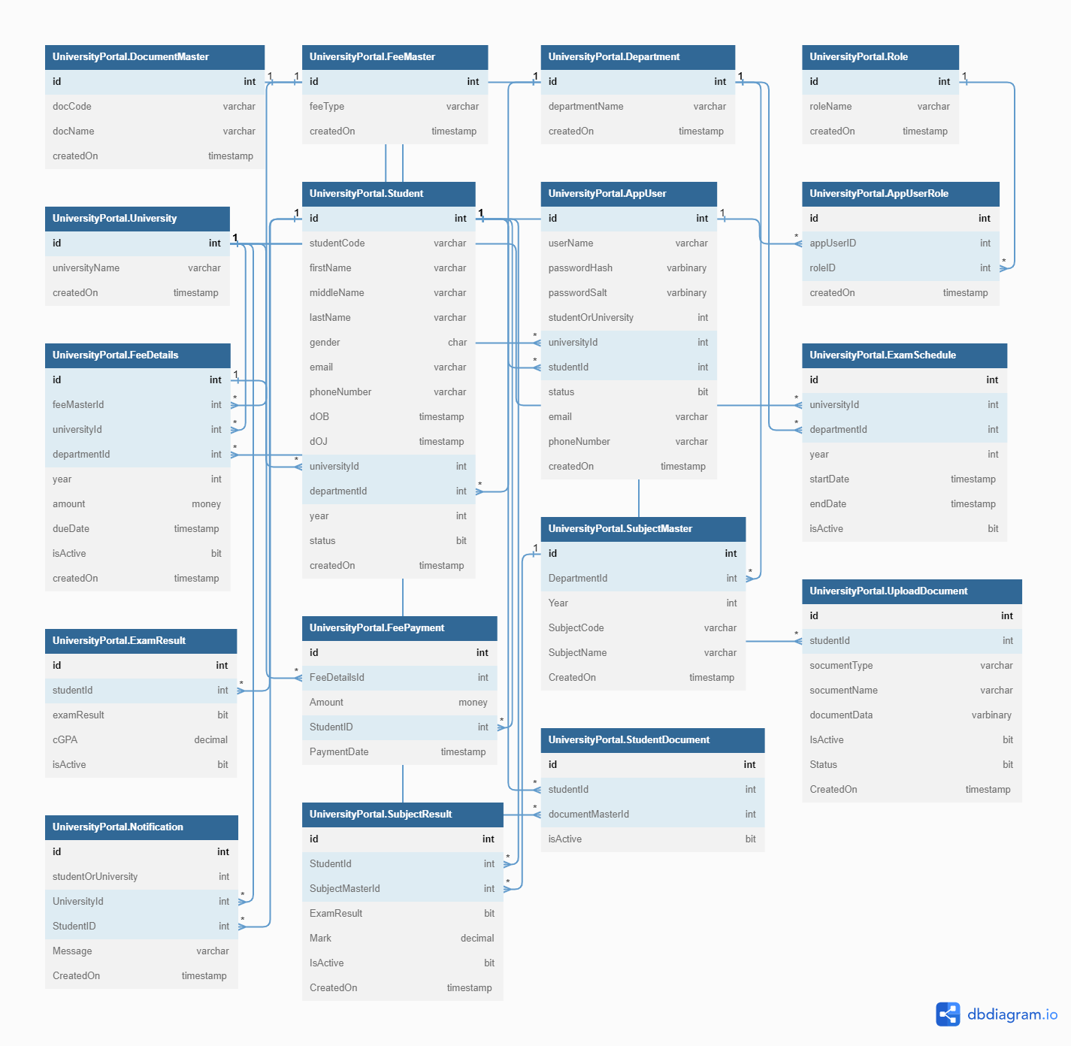
DB Diagram

Slide 5

Components used
Wed Development | Asp.net Core MSC
Front end UI | Bootstrap
Backend | SQL Server DB

Slide 6
SKILL-UP TEAM
Viswanathan Meenatchisundaram
Aravind Kumar Ravichandran
Aneeshan Ramalingam
Monish Nerlay
Rajarajan Nagaiyah

Slide 7
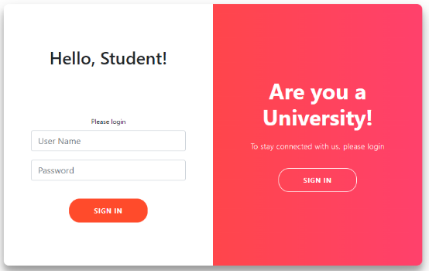
R Solutions Website
Let’s have a look.

Slide 8
THANK YOU
Team Skill-Up

